Slide 1
Revising the Provincial Bark Beetle Strategy
Tim Ebata,
Provincial Forest Health Officer
Resource Practices Branch

Slide 2
Why have a Provincial BB Strategy?
Original intent was to support the Forest Practices Code Bark Beetle Regulation (BBR) as government’s MPB outbreak response
Stratified very large areas into Aggressive, Containment and Salvage Zones of the EBBMA
Since then (2003), the document has not been touched as it became less relevant as there are no multi-region outbreaks at the same scale as MPB
Under the BBR’s Emergency Bark Beetle Management Area designation, it communicated to industry where special provisions could be applied to expedite sanitation harvesting
The BBR provisions were redundant due to the flexibility within FRPA and was repealed
Last EBBMA map (2013) mainly used to guide application of BSPs, Haul Differentials and access to salvage rates

Slide 3
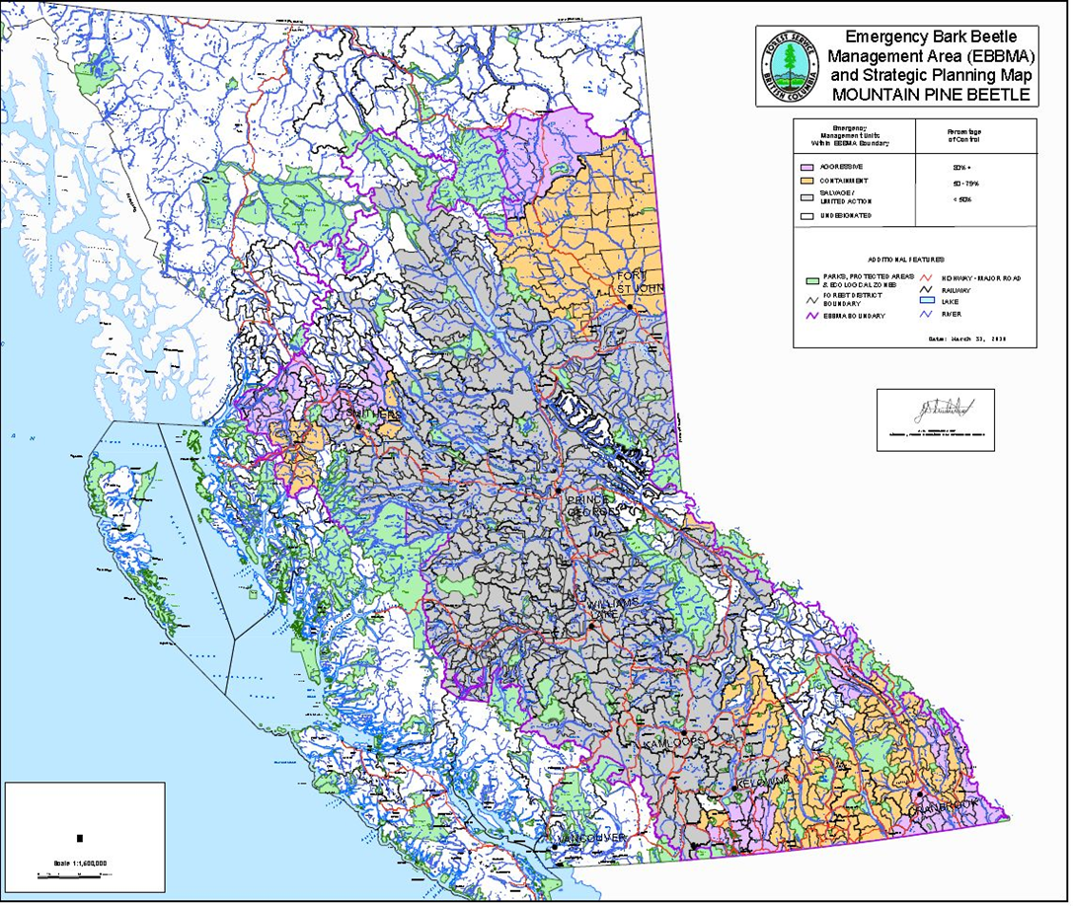
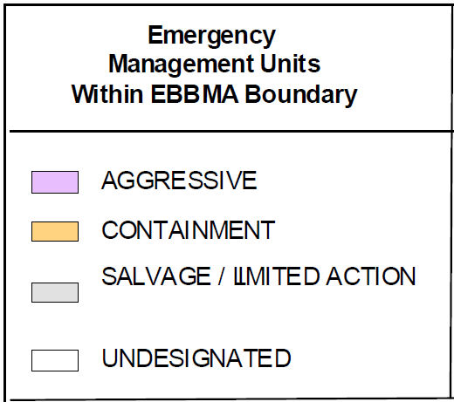
2013 Emergency Bark Beetle Management Area Map
Maps for SB and DFB were also produced
Aggressive EMUs = Suppression BMUs

Slide 4
Why have a new strategy?
Recent outbreaks of spruce and Douglas-fir beetle highlighted the need for a provincial strategy to rationalize funding requests across regions and districts and identify where BSPs can be used for sanitation harvesting
Main objective: describe how, at a provincial scale, government sets priorities for managing bark beetles and how we intend to track performance

Slide 5
Objectives of the “new” Provincial BB Strategy
Ensure most current BMU strategies are communicated to all on a regular basis and in a standardized manner
Clarify methods for assigning Beetle Management Unit Strategies for MPB, SB and DFB (i.e., prevention, suppression, holding, salvage, monitor) at the TSA/District level
Describe the metrics used to define the BMUs and help set priorities at a district, regional and provincial scale
Same metrics are used to develop funding requests and track performance
Strategy describes where efforts should be applied; Bark Beetle Guidebook information gives the “how to” guidance on tactics and practices
Provincial-scale communication of FLNRO strategy to address bark beetles

Slide 6
Challenges
The original strategy and BMU concept was designed specifically for MPB management (“80% brood reduction = suppression”)
Both Spruce Beetle and Douglas-fir beetle are different in behaviour from MPB, thus management options vary
Detection of green attack is more challenging for SB and DFB than MPB
Predictive model support very limited for SB and DFB
Setting BMU treatment targets are likely very different between beetle sp. – but are the treatment objectives also different?
Do we need a different approach to identify priority areas?

Slide 7
General Approach
The BMU is assigned a beetle species-specific strategy based on:
  Number of attacks (red and estimated green)
  Distribution of attacks (spots or patches)
  Proportion of the green attack that can be treated – factoring in available resources and treatment constraints
  Impact potential – susceptible volume present in the unit and expected mortality rate if an outbreak occurs + threats to other non-timber values
  Bottom-line: What is the probability of reducing brood production to the target level?
  Criteria above used by districts to update District/TSA forest health strategies
  Currently, no provincial roll-up

Slide 8
Current Guidance – Spruce Beetle GB pg.5
Strategies for spruce beetle are similar to those for mountain pine beetle and other bark beetles
Choice of management strategies for spruce beetle will depend on:
  The size and pattern of the infestation
  The severity of the attack in each of the last three years
  The vigour and survival of the new broods
  The stand hazard
  Integrated resource management issues/constraints
  Existing and future access
  Harvesting operability
Missing is a threshold for treatment but in Omineca’s situation, is suppression really an objective? Reduced to “slow the spread”.
How to represent the “line in the sand” spatially?

Slide 9
Current Guidance – Douglas-fir Beetle
Posted on the “Management of the Douglas-Fir Beetle” web page
Strategies setting depend on a several factors:
  infestation size
  stand susceptibility
  values
  access
  infestation history.
Missing: no thresholds – interpretation and application left up to districts with regional oversight. Is strategy to suppress or to protect specific resource values (smaller than a BMU)?

Slide 10
Metrics – already tracked but not standardized
Aerial survey results = Infestations detected
Ground detection results = specific green attack data
Infestations assigned to specific parties to treat
Ongoing treatment progress
Final treatment results – sites treated by responsible party
Costs/outputs: FLNRO - Aerial and ground detection (area surveyed); trap trees (# trees or sites), single tree treatments (numbers of trees treated), baits and traps (# placed)

Slide 11
Performance Reporting
Annual reporting possible of % of identified infestations that were addressed before beetle flight
Reporting by responsible party would be possible
Trends in beetle attack over several years would document efficacy of efforts by BMU
Allow for rational allocation of resources and/or changes in strategy and tactics
Communicate performance

Slide 12
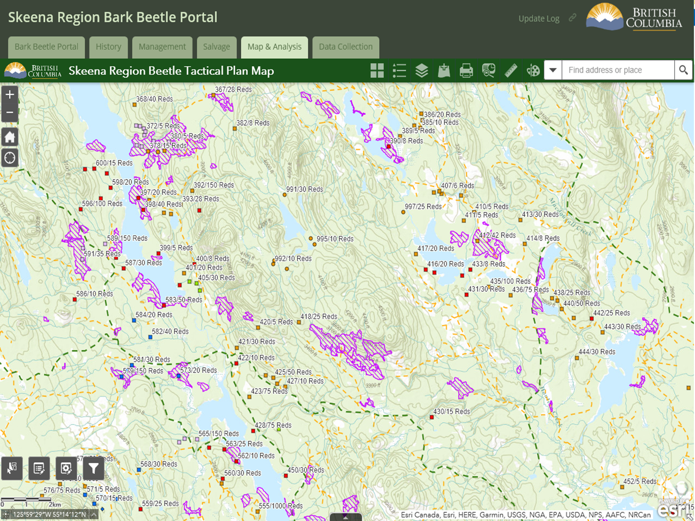
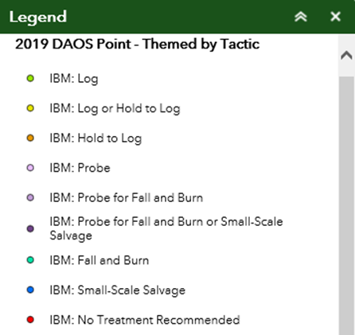
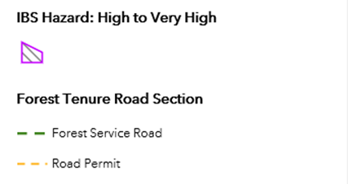
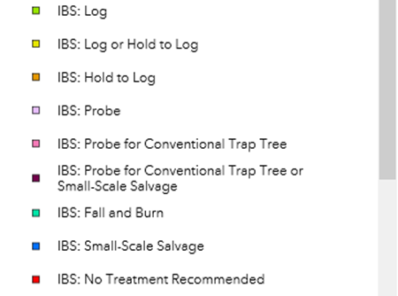
Online Application
Example

Slide 13
Timelines
Entomologists develop target threshold for BMU suppression targets for DFB and SB – Fall 2020
Prepare clear guidance on assigning BMU strategies – Fall 2020
Prepare draft strategy and distribute to regions and districts for comment along with standard table format – Winter 2020
Identify workload required for BMU updates and get commitments
Assign update task and deadlines –March 2021
OUTPUT: ArcGIS online BMU map to display district BMU info they submit (EASY)

Slide 14
Questions?
Contact:
  Tim Ebata, Provincial Forest Health Officer
  Babita Bains, Provincial Forest Entomologist

